Slide 1
Making Your First Windows 10 app
January 28th, 2015

Slide 2
Getting Started
What we will be working with: Visual Studio
What we will be coding in: C# and XAML
(You can program in C++ or HTML with JavaScript if you are more comfortable)

Slide 3
XAML
Extensible Application Markup Language
A lot like HTML or XML
Powerful controls
Custom controls
Data binding
Directly link object properties to UI properties

Slide 4
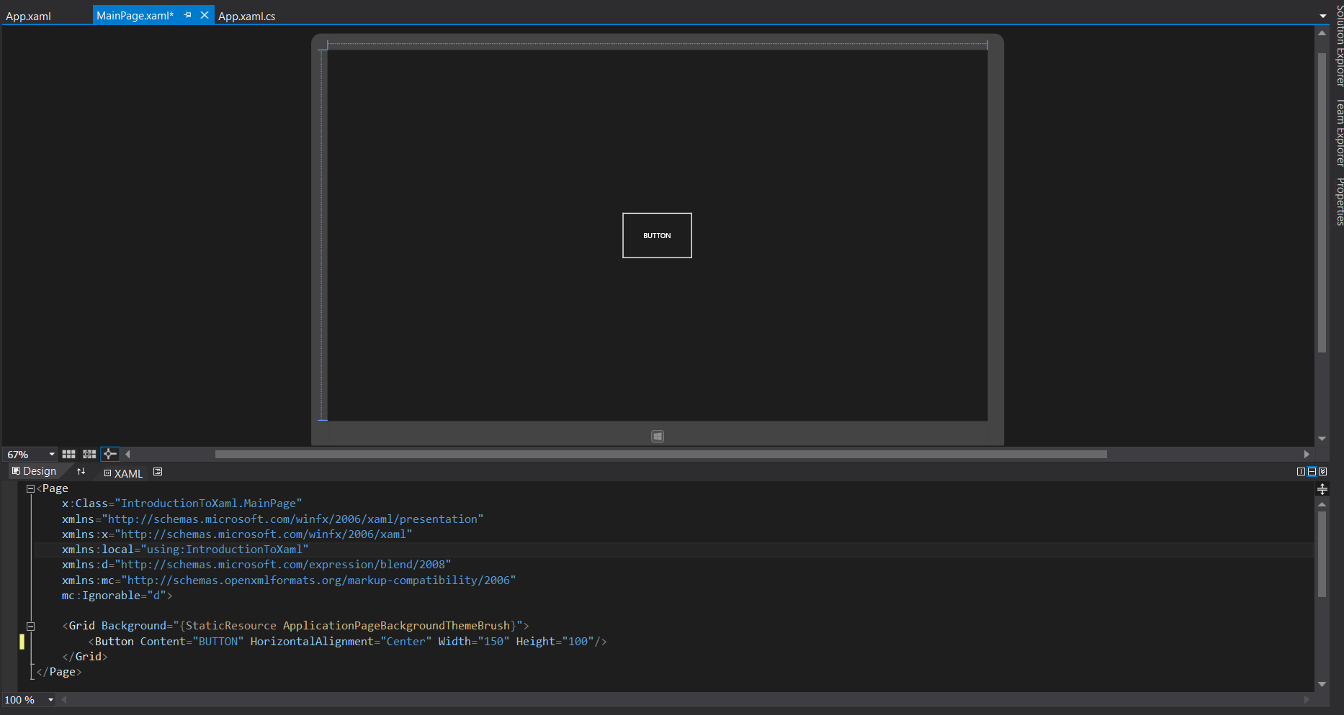
XAML (cont.)

Slide 5
Making the Project
Well make an app that pulls data from Michigan State’s Cafeteria’s Menu
Were going to be interacting with a RSS Feed
RSS= Really Simple Syndication

Slide 6
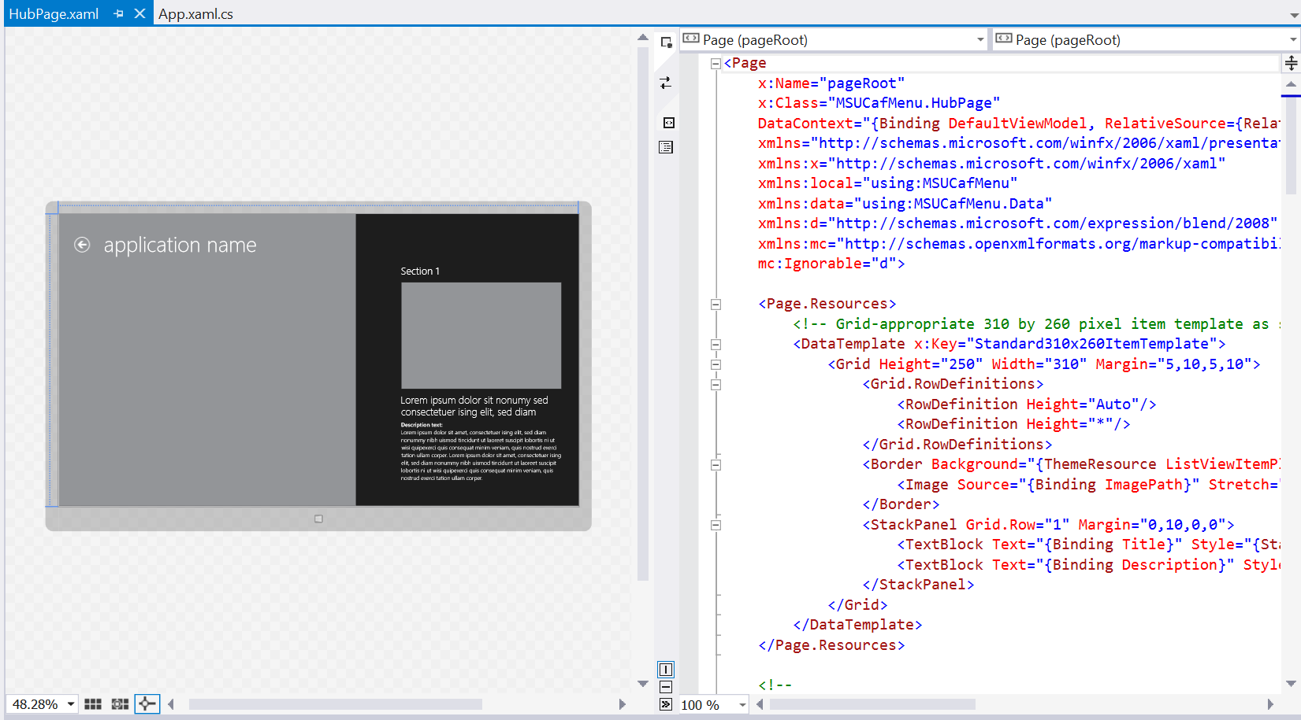
Starting out
We start with template for a Universal Hub App

Slide 7
Lets setup the UI
Give it a Name
Give a nice background
Remove default content

Slide 8
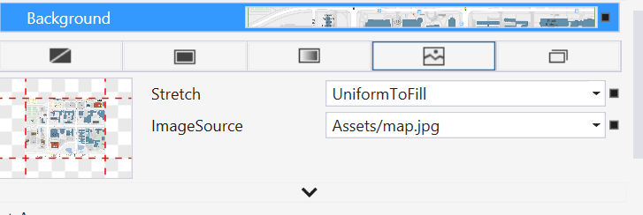
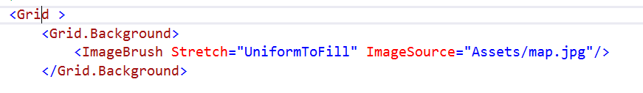
Background Image
Property editor generates this xaml

Slide 9
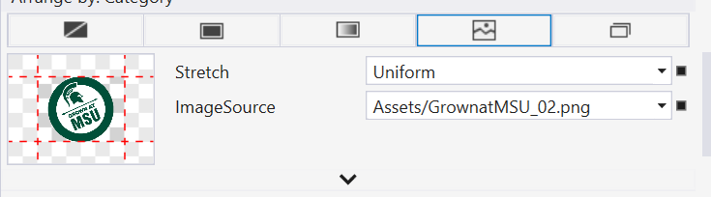
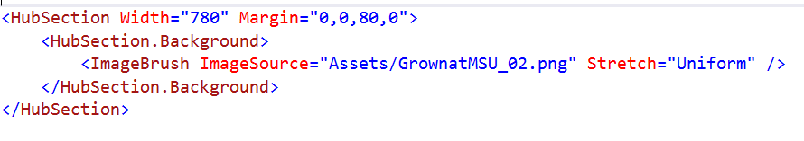
Cover Image
Property editor generates this xaml

Slide 10
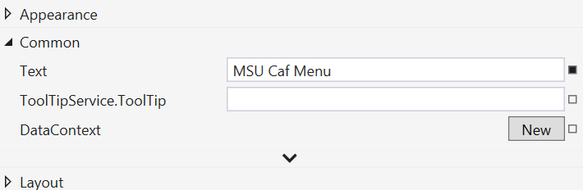
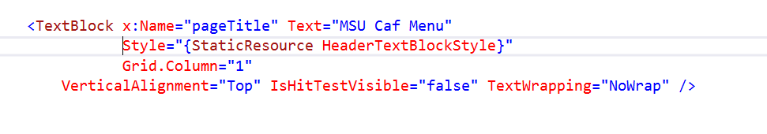
Title
Property editor generates this xaml

Slide 11
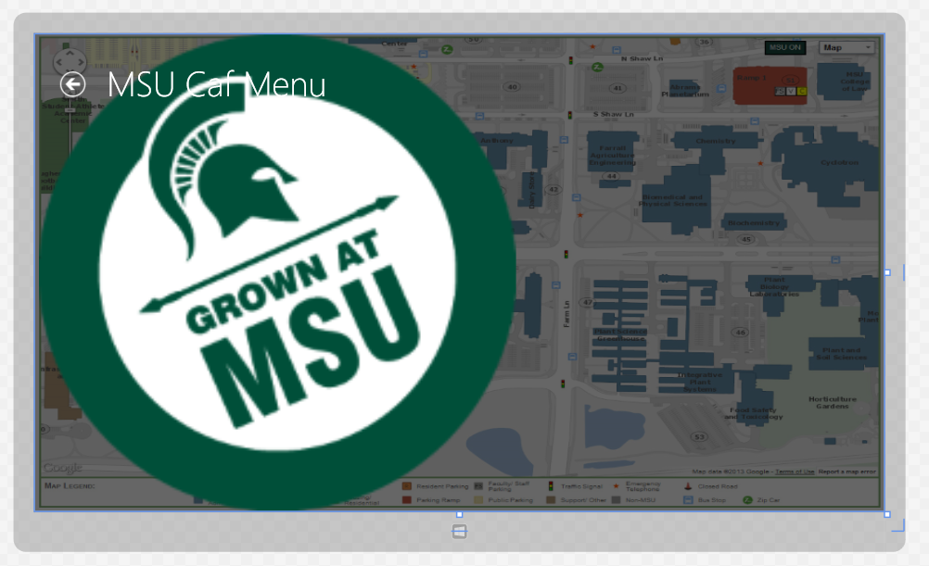

Slide 12
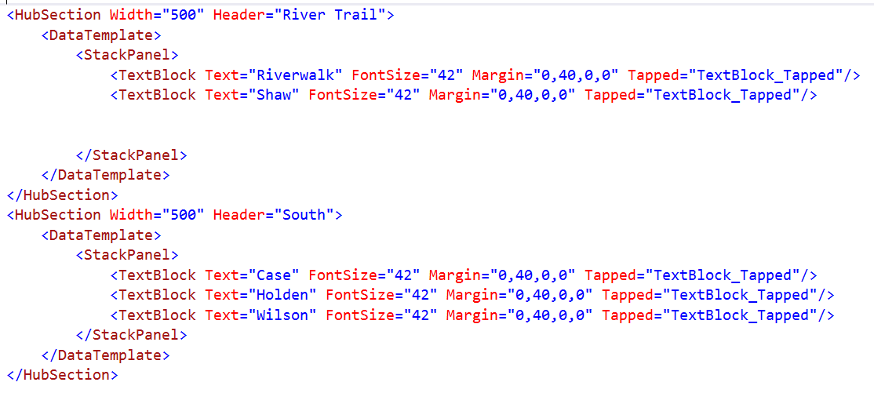
Lets add in the cafeterias
Using:
StackPanels
This helps to keep items from stacking on each other
TextBoxs
This will hold our text

Slide 13
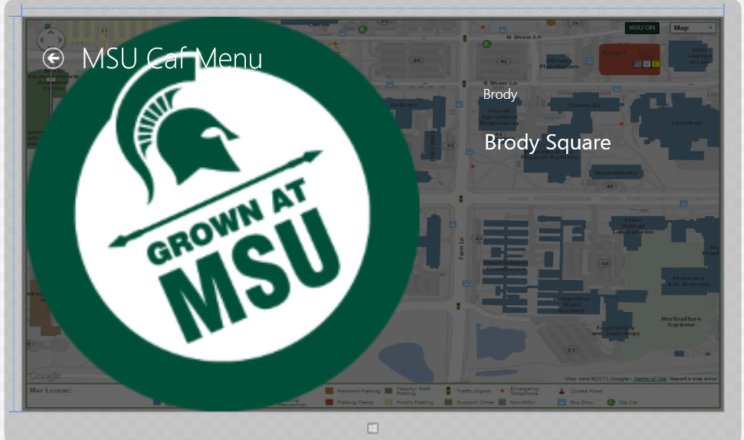
New UI

Slide 14
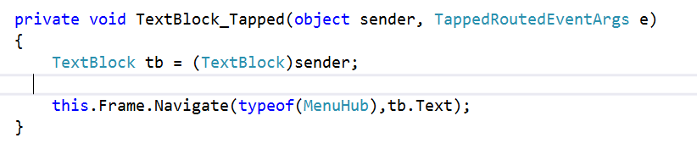
Navigating to a new page
We will navigate to a new MenuHub page
We will send the name of the cafeteria with it
Happens when we tap on a TextBox on the main screen]
In this example we send the value “Case”

Slide 15
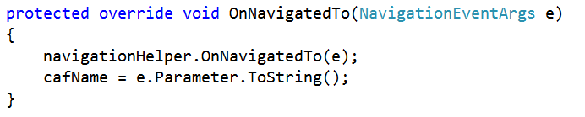
Retrieving data
Once we navigate we will pull the value
Store it in a global called cafName
e.Parameter should be “Case”

Slide 16
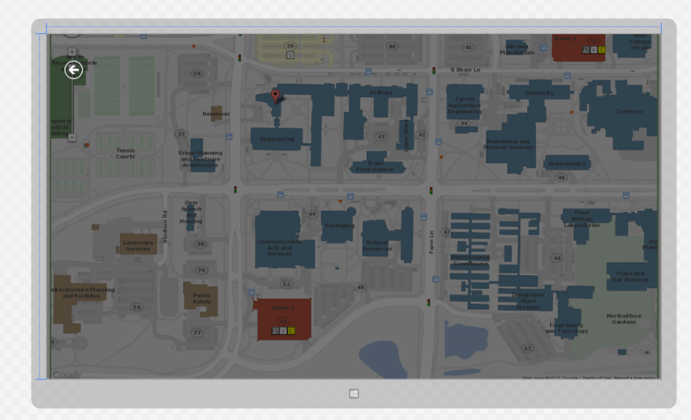
Making the Menu Page
All content will be generated upon loading

Slide 17
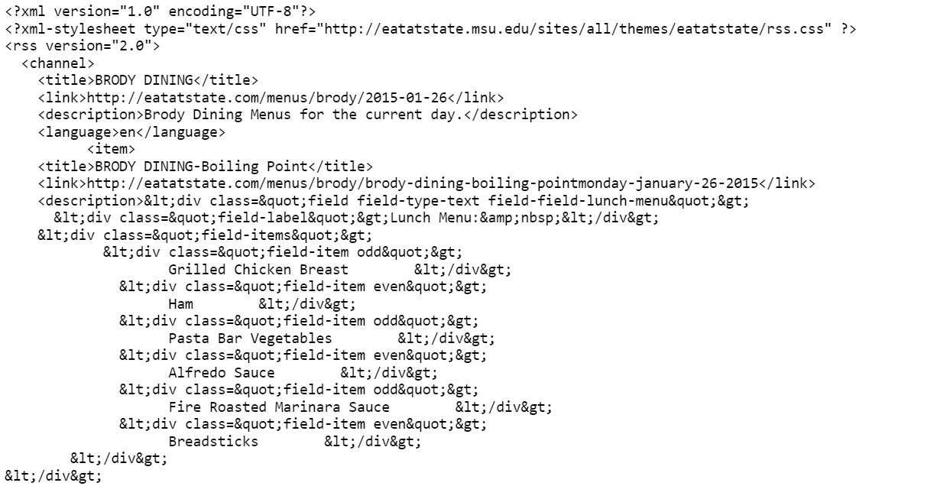
Lets pull the Menu content
Data formatted in RSS
MSU puts HTML code inside the RSS
Not recommend
Barely readable

Slide 18
How will we store the content?
Well create two classes:
CafStation
Cafeteria

Slide 19
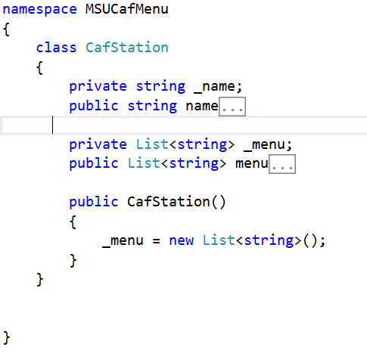
CafStation
Holds all of the menu data and the name for each station
Properties:
Name, string, Name of the station
Menu, List of strings, actual menu contents

Slide 20
Cafeteria
Responsible for:
Pulling data
Storing data into a collection of CafStations
Properties
Name, name of the cafeteria
CafStations, list of CafStations
Methods
getMenu();
Pulls data asynchronously, (does not stop the UI)
Returns list of CafStations

Slide 21
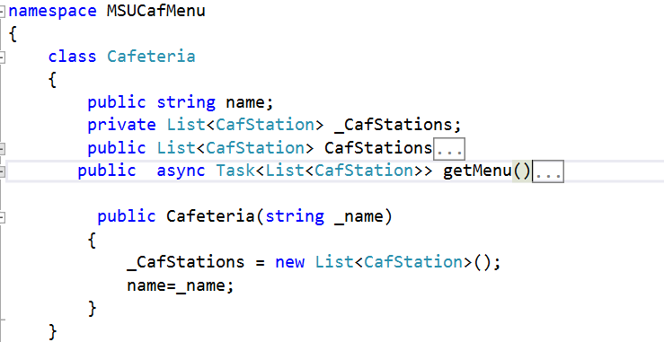
Cafeteria

Slide 22
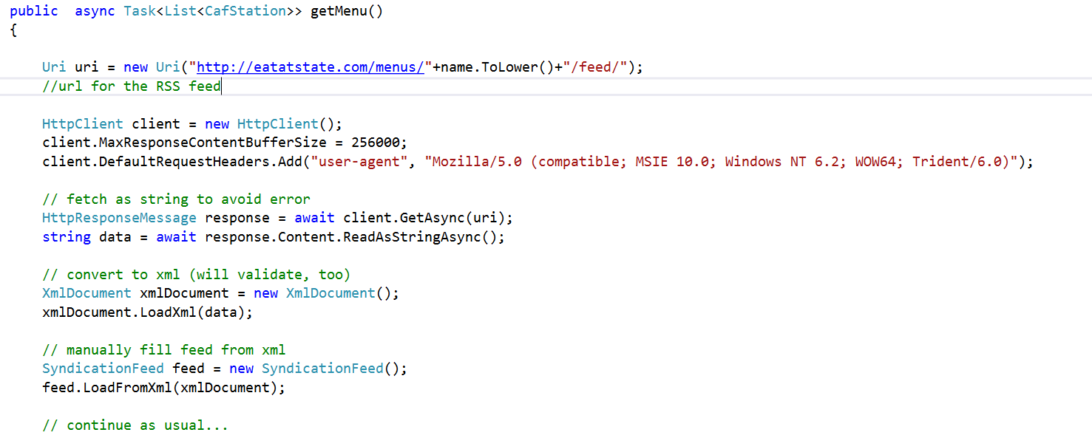
getMenu()
String data is all of the text
We convert that into the actual xml document

Slide 23
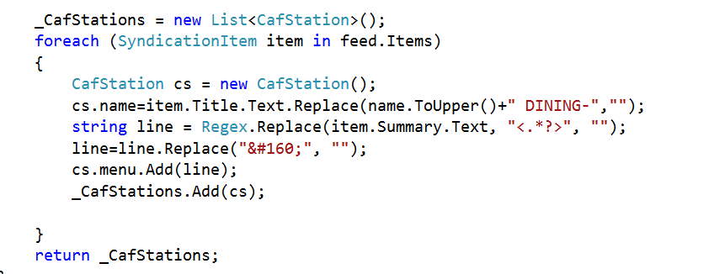
getMenu()
We will store the data into a CafStation object
We clean out HTML tags and unnecessary text
Using regex and string.replace()
Regex is smarter that string.replace()

Slide 24
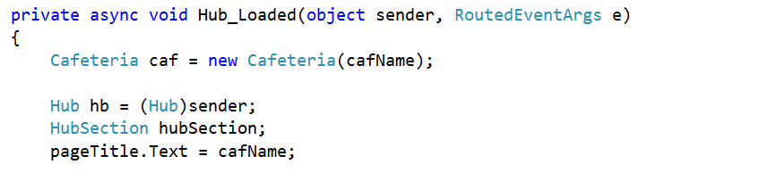
Lets connect this to our UI
Code starts when the Hub control is generated
Well create our cafeteria object here
Well add a title to this page here too

Slide 25
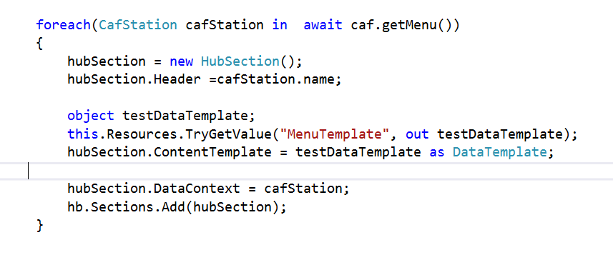
Dynamically adding content
Well get our list of CafStations by calling our object caf, and its method getMenu()
We use await because it is an asynchronous method
We set the Hub Section header to cafStation’s name

Slide 26
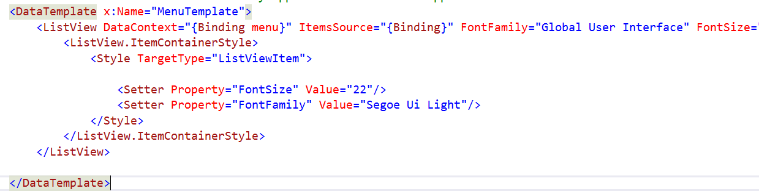
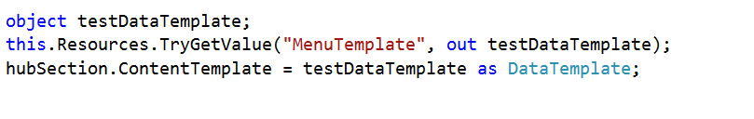
Applying a template
HubSection’s content is pulled from the MenuTemplate we created in xaml

Slide 27

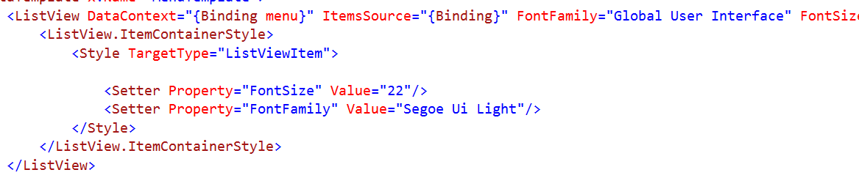
Data Binding
Setting a UI property to an objects property.
Such as a text property to a name property
If we change the name later in code, the text property will change too
We bind the HubSection to our CafStation
We also bind the HubSections ListView collection to the CafStations menu property

Slide 28

Adding the content
In the end we add the new HubSection to our main Hub
This is done for all CafStations inside of the Cafeteria object

Slide 29
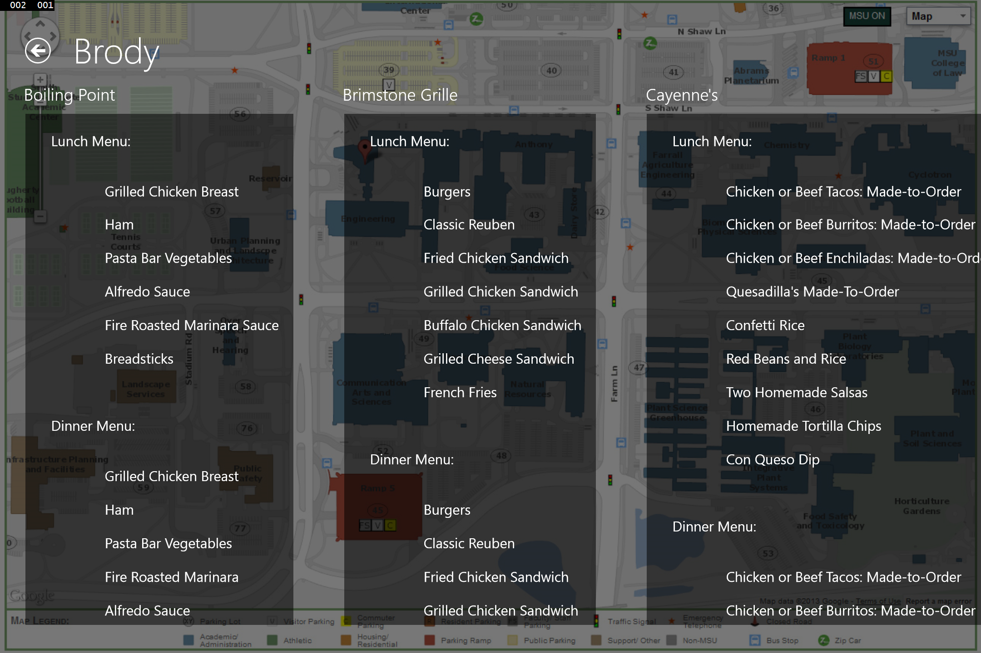
After generation
Since each cafeteria has different stations, hub sections must be generated dynamically

Slide 30
What’s Next
You could store the data locally if you lost internet connection
You could setup location based services to show you the menu when you are by a cafeteria
Send a notification when a cafeteria has your favorite food

Slide 31
Want to develop your own?
Do you need Visual Studio?
Check out Microsoft Dreamspark
https://www.dreamspark.com/
All students get a free copy
I have Visual Studio where do I go to learn?
MSDN, Microsoft Developer Network has loads of samples
https://code.msdn.microsoft.com/windowsapps
Look for examples on YouTube

Slide 32
Questions?

Slide 33
Contact Information
Matt Pasco, Microsoft Student Partner
Matthew.Pasco@studentpartner.com
(248) 842-4095
Facebook: Microsoft @ Michigan State University,
https://www.facebook.com/groups/MSFTatMSU/

